Slide 1
Quality of Pareto set approximations
Eckart Zitzler, Jörg Fliege, Carlos Fonseca, Christian Igel, Andrzej Jaszkiewicz, Joshua Knowles, Alexander Lotov, Serpil Sayin, Andrzej Wierzbicki
4.5 EMO, 4.5 non-EMO

Slide 2
Lessons learned
This chapter is a must
Obvious things are not obvious

Slide 3
Outline
Motivation
Use cases
  Testing (true Pareto front is known)
  Practice (true Pareto front is not known)
Comparing approximations
  Unary measures
  Binary measures
Discussion and conclusions

Slide 4
Motivation
Comparison of algorithms
  Pictures are valuable but not sufficient
Design of algorithms for vector optimization
  To guide the search
  Stopping criteria
Learning

Slide 5
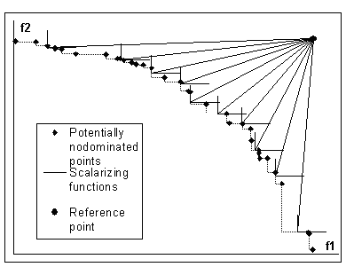
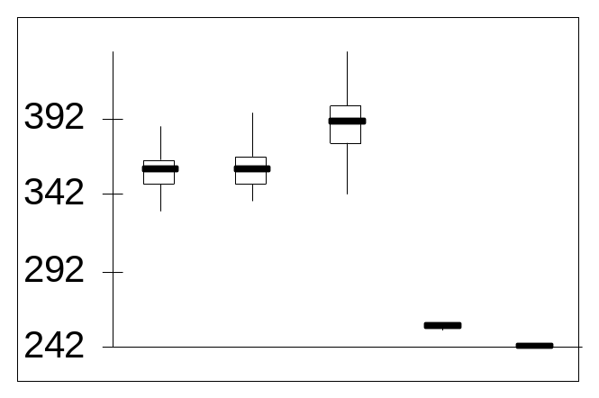
Use cases
Testing
  True Pareto front is known
Practice
  True Pareto front not known in general
  Additional useful information:
    Lower bounds through relaxation
    Upper bounds through random search or other methods
    …
  Pairwise comparison

Slide 6
Comparing approximations
Unary measures
  Evaluation of a single approximation
Binary relations
  Purely ordinal
Binary measures
  Evaluation of difference between two approximations

Slide 7
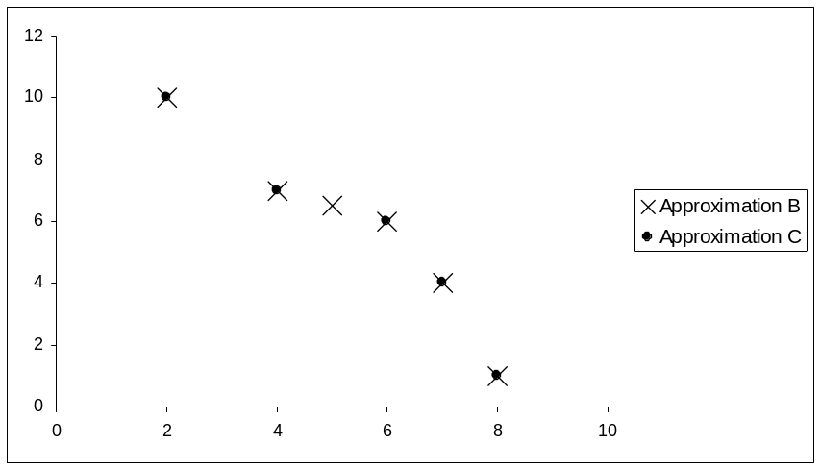
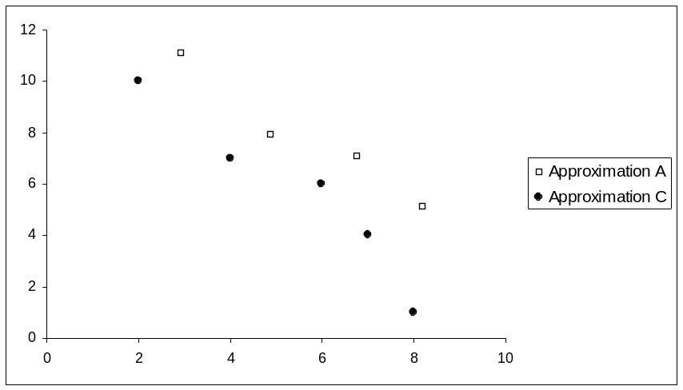
Unary measures
Assign a real number to a Pareto set approximation
Relevant properties
  Monotonicity (strict or not)
  Uniqueness of optimum
  Scale invariance
  Computational requirements
  Required information, e.g. reference set, bounds

Slide 8
Examples of unary measures
Outer diameter
Proportion of Pareto-optimal points found
Cardinality
Hypervolume
ε-dominance
D-measures
  D1 - mean value of the Chenycheff distance from the Pareto front
  D2 – asymmetric Hausdorff distance with Chebycheff metric
R-measure - expected value of Chebycheff scalarizing function
Uniformity measures
Probability of improvement through random search
Combinations of the above measures

Slide 9
Binary measures
Relevant properties
  Monotonicity (strict or not)
  Scale invariance
  Computational requirements
  Required information, e.g. bounds
Transformation of measures into relations
  Partial orders stronger than dominance may be constructed
  Implicit introduction of preferences

Slide 10
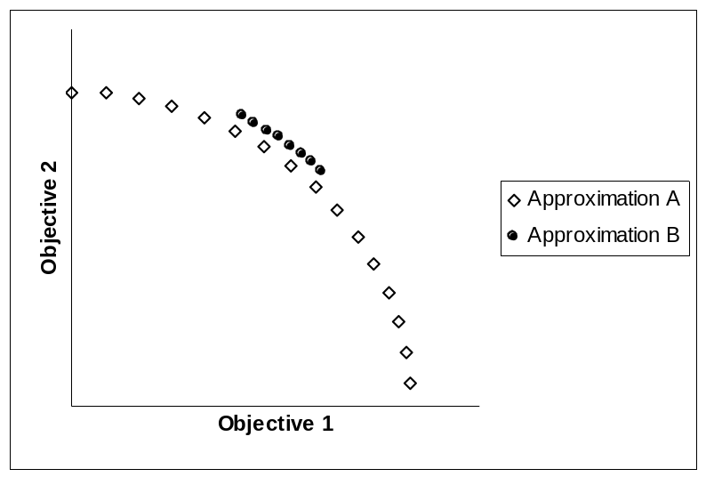
Examples of binary measures
Difference of two unary measure values
Pareto dominance of sets
Binary ε-dominance
Hypervolume of difference between two Edgeworth-Pareto hulls
Coverage

Slide 11
Discussion and conclusions
Evaluation of algorithms – not discussed here
Taking into account preference information - not discussed here
Monotonicity is important in theoretical sense
In practice it may be relaxed
  Learning
  Practical optimization algorithm may benefit from this relaxation, like constraint relaxation in numerical optimization
Computational complexity also influences the choice of performance indicator(s)

